Slide 1
DEVELOPMENT WITH A DIFFERENCE
PROFESSOR KAMARULAZIZI IBRAHIM PHD
Director
Centre for Global Sustainability Studies
Universiti Sains Malaysia
11800 Penang, MALAYSIA
kamarul@usm.my
©ki/ppsf/usm/2014

Slide 2
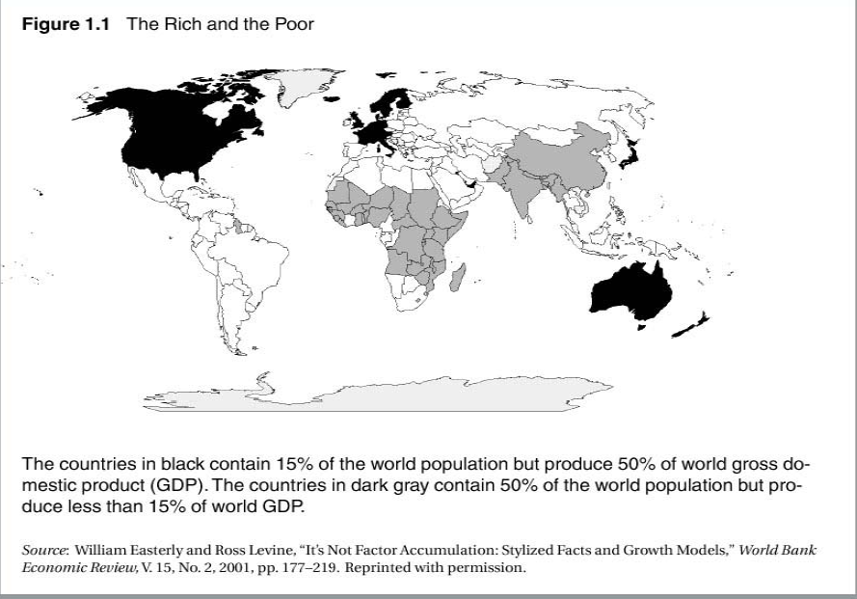
THE RICH AND THE POOR

Slide 3
Principles and Concepts: Economic Development
What is the real meaning of development?
How can one apply economic concepts and theories to gain a better understanding of development process?
Why do some countries develop and others remain poor?
What are the sources of development and how do we measure development?

Slide 4
Principles and Concepts: Economic Development
Does historical record of development help us understand it better?
What are the most influential theories of development and are they compatible?
Is development process of developing nations independent or interdependent with that of developed nations?
Does historical record of development help us understand it better?
What are the most influential theories of development and are they compatible?
Is development process of developing nations independent or interdependent with that of developed nations?

Slide 5
Definitions of Development
For almost every writer a different definition of development exists
Important to first distinguish between:
Development as a state or condition-static
Development as a process or course of change- dynamic

Slide 6
Definition of Economic Development: 1950s
In economic terms, development is the capacity of a nation to generate and sustain an annual increase in its GNP of 5% or more.
Traditional economic measures:
GDP: is the market value of all final goods and services produced within a country in a given period of time
GNP: is the market value of all final goods and services produced by permanent residents of a country in a given period of time
GNP= GDP+ net factor income from abroad

Slide 7
Definition of Economic Development:
Common alternative index is the rate of growth of income per capita or per capita GNP
Per capita GNP: is the per-head value of final goods and services produced by permanent residents of a country in a given period of time. It is converted to USD using the current exchange rate.
PPP Measure: the number of units of a country’s currency required to purchase the same of basket of goods and services in the local market that a US $1 would buy in the USA. Under PPP, exchange rates should adjust to equalize the price of a common basket of goods and services across countries. Penn World Tables rank countries using the PPP method.

Slide 8
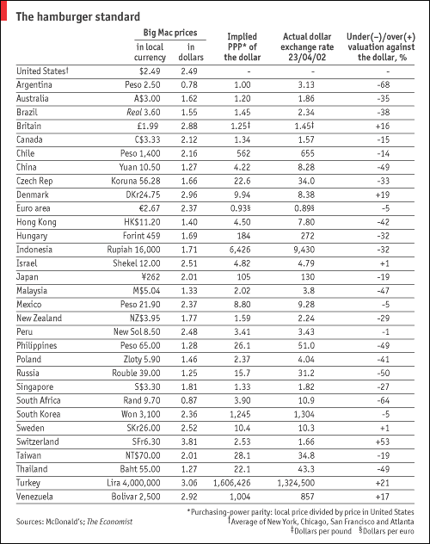

Slide 9
Comparison of GNP
 | GNP Per Capita (US $)
Country | Exchange rate | PPP
UK | 24,500 | 23,550
USA | 34,260 | 34,260
Zimbabwe | 480 | 2,590
Bangladesh | 380 | 1,650
China | 840 | 3,940
India | 460 | 2,390
Sri Lanka | 870 | 3,470

Slide 10
Definition of Economic Development: 1970s
Dethronement of GNP in the 1970s and increasing emphasis on “redistribution from growth”
Increasing emphasis on non-economic social indicators
Economic development consists of the reduction or elimination of poverty, inequality and unemployment within the context of a growing economy.

Slide 11
Human goals of economic development : Sen’s “Capabilities” Approach: 1985
Economic growth is not an end in itself and has to enhance the lives people lead and the freedoms that they enjoy
Capability to function is what matters for status as a poor/non-poor person and it goes beyond availability of commodities
Capabilities: “freedom that a person has in terms of the choice of his functionings,…”
Functionings is what a person does with commodities of given characteristics that they possess/control

Slide 12
The concept of functionings reflects the various things a person may value doing
Therefore, development cannot focus only on income, but we also need to look at other factors impacting a person’s capability to function.
Amartya Sen traced five sources of disparity between real incomes and actual advantages:
Personal heterogeneities
Environmental diversities
Social climate variations
Differences in relational perspectives
Distribution within family

Slide 13
Definition of Economic Development: 1990s
World Bank in its 1991 WDR asserted that the “challenge of development is to improve the quality of life.”
The improved QOL involves higher incomes, better education, higher standards of health and nutrition, less poverty, a cleaner environment, more equality of opportunities, greater individual freedom, and a richer cultural life.
World Bank in its 1991 WDR asserted that the “challenge of development is to improve the quality of life.”
The improved QOL involves higher incomes, better education, higher standards of health and nutrition, less poverty, a cleaner environment, more equality of opportunities, greater individual freedom, and a richer cultural life.

Slide 14
Economic factors
capital
Labor
Natural resources
technology
established markets (labour, financial, goods)
Non-economic factors (institutional, social, values)
attitudes toward life and work
public and private structures
cultural traditions
systems of land tenure, property rights
integrity of government agencies

Slide 15
Meaning of Development-Todaro
Development is not purely an economic phenomenon but rather a multi-dimensional process involving reorganization and reorientation of entire economic AND social system
Development is process of improving the quality of all human lives with three equally important aspects. These are:

Slide 16
Todaro’s Three Objectives of Development
1. Raising peoples’ living levels, i.e. incomes and consumption, levels of food, medical services, education through relevant growth processes
2. Creating conditions conducive to the growth of peoples’ self-esteem through the establishment of social, political and economic systems and institutions which promote human dignity and respect
3. Increasing peoples’ freedom to choose by enlarging the range of their choice variables, e.g. varieties of goods and services

Slide 17
Alternative Interpretations of Development
Development as Modernization- emphasizes process of social change which is required to produce economic advancement; examines changes in social, psychological and political processes;
How to develop wealth oriented behavior and values in individuals; profit seeking rather than subsistence and self sufficiency
Shift from commodity to human approach with investment in education and skill training

Slide 18
Alternative Interpretations of Development
Development as Distributive Justice- view development as improving basic needs
Interest in social justice which has raised three issues:
1.Nature of goods and services provided by governments
2. Matter of access of these public goods to different social classes
3. How burden of development can be shared among these classes
Target groups include small farmers, landless, urban under-employed and unemployed

Slide 19
Definition of Economic Development:
Conclusion:
“Development is a multi dimensional process involving changes in social structures, popular attitudes, and national institutions, as well as the acceleration of economic growth, the reduction of inequality, and the eradication of poverty.” (Todaro and Smith)

Slide 20
Development is both a physical reality and a state of mind for attaining a better life.
Three basic core values as a practical guideline for understanding development
Sustenance
Self-esteem
Freedom
Specific components of better life vary from time to time and from society to society.
Three Objectives of Development:
Increase availability and distribution of basic goods
Raise levels of living
Expand range of social and economic choices available to individuals

Slide 21
Human Development Index
Initiated in 1990 and undertaken by UNDP in its annual series of HDRs.
HDI is based on 3 goals:
Longevity
Knowledge
Standard of living
HDI= 1/3(Income index)+1/3(Life expectancy index)+1/3(education index)

Slide 22
Human Development Index
Ranks 175 countries into 3 groups
Low human development = 0.00-0.099
Medium human development = 0.5-0.799
High human development = 0.80-1.00
Country | HDI | GDP rank-HDI rank
Low HD: Tanzania | 0.436 | +21
Medium HD: Turkey | 0.735 | -21
High HD: Canada | 0.936 | +3

Slide 23
Sustainable Development vs. Sustainability
Sustainability is the capacity to endure. For humans it is the potential for long-term health and wellbeing, which in turn depends on the wellbeing of the natural world and the responsible use of natural resources.
Sustainable development is “development that meets the needs of the present without compromising the ability of future generations to meet their own needs.” There are many definitions of sustainable development, but this is the one that is most frequently used. It contains two key concepts:
the concept of needs, in particular the essential needs of the world’s poor, to which…priority should be given; and
the idea of limitations imposed by the state of technology and social organisation on the environment’s ability to meet present and future needs.

Slide 24
SUSTAINABLE DEVELOPMENT
Sustainable development (SD) or sustainability is the imperative of the 21st century
Sustainability - Protecting our planet, lifting people out of poverty and advancing economic growth are interconnected aspects of the same principle
The current developmental paradigm that puts considerable pressure on natural resources, resulting in environmental degradation, change climate and widening of the gap between the poor and rich further, is simply not sustainable.
Developed countries will continue efforts to sustain their living standards and maintain economic growth, developing countries are on a fast track to become ‘developed’
Pursue a new way of building resilience to avoid undesired outcomes in the future through reducing current risks posed by human actions that are changing significantly Earth and its environment.
Define risk more inclusively to cover both ‘rapid onset–high impact’ events such as floods and heat waves, and ‘slow onset–high impact’ events such as climate change and poverty, which are sustainability challenges.
©ki/ppsf/usm/2014

Slide 25
COMPARISON
Sustainable
development
Disaster
Added risk to normal development
A risk factor

Slide 26
Approach
Disaster risk management (DRM) will be used to show the difference between the traditional approaches used in the past/present and the new model we propose to support SD globally.
In the new model we integrate the usual four components of DRM– prevention, preparedness, response and recovery – to meet the needs of SD.
In most developing countries, conventional disaster management is limited to event-based reactive engagements, while proactive disaster management calls for stronger preparedness and response measures
©ki/ppsf/usm/2014

Slide 27
neo-DRM
The ‘neo-DRM’ will strengthen the prevention and recovery components of DRM, including the cost-effective and win-win measures.
This could involve a host of country- specific activities such as
community-based resilience building towards disasters,
efficiency improvements in energy and water use, fisheries and land use through training and capacity enhancement,
process-based approaches to mitigation and risk sharing,
Technology-assisted early warning systems, better public transport, improved hydro-met services, smart policies and innovative implementation through public–private partnerships for multiple pilots and scaled-up projects.
Integrated SD policies for development planning and protection of coastal cities, flood plains, estuaries, forests and national biodiversity.
In the absence of anticipatory action, these risks will get harsher as the population grows, the world
warms and global environmental changes accelerate. Any and all proactive measures to ameliorate the adverse impacts of these events will help greatly in managing their potential risks towards a more sustainable future.
©ki/ppsf/usm/2014

Slide 28
neo-DRM-SD
Combining mitigation, adaptation and readiness as pre-disaster risk-reduction measures, and post-disaster measures such as relief, restoration and overall rehabilitation.
Achieving the desired sustainability objectives by factoring sustainable development (SD) considerations in all the four major phases of the DRM loop – prevention, preparedness, response and recovery.
The overall risk (in the absence of any risk-reduction measures) will be progressively reduced to a level where any resulting disaster from the residual risk will be considered manageable
©ki/ppsf/usm/2014

Slide 29
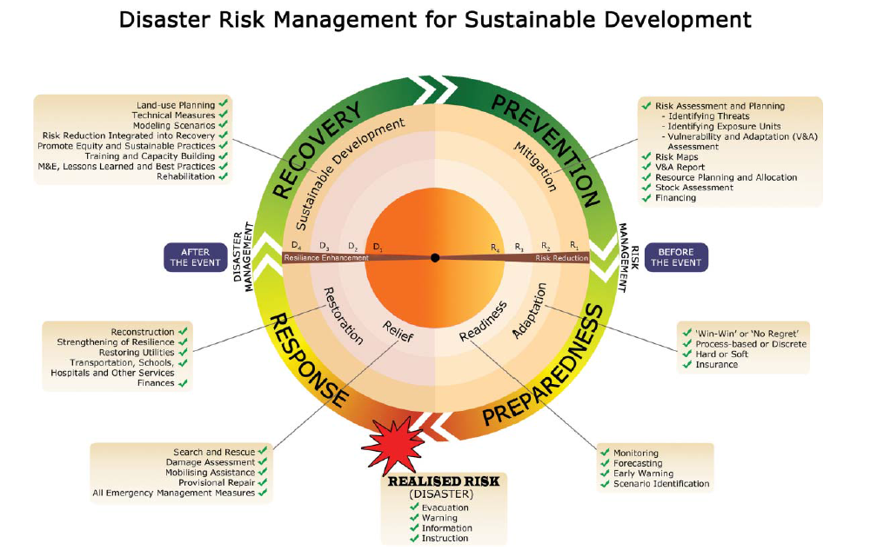
neo-DRM-SD Model
The key to successful implementation of the model is the ability to progressively reduce risk through mitigation (R1), adaptation (R2) and readiness (R3) measures carried out ‘before the event’ under prevention and preparedness. The residual risk is shown by R4 which when realized as disaster (D1) is presumably small and manageable. The post disaster activities relief (D2), restoration (D3) and sustainable development (D4) will enhance resilience (reduced disaster) under response and recovery phases.
©ki/ppsf/usm/2014

Slide 30
developing country
A developing country on fast-track towards
developed status generally will :
adopt sustainable technologies (Green technology) quickly and across the nation,
strive to eradicate abject poverty, while simultaneously accelerate activities to alleviate relative poverty, i.e. ‘hardship alleviation’,
preserve the environmental resource base and life-supporting mechanisms (the natural capital) through risk assessment and rehabilitation of hotspots,
ensure food, water, energy and human security through good governance,
public–private partnership, strategic environmental assessment and setting SDGs and promote education for SD and sustainability science for sustained economic growth, social cohesion and overall well-being of people
Thus moving from an event based to a process based intervention strategy for disaster risk reduction/management (DRR/M), in which case, the vulnerable communities will become active participants rather than remaining as passive victims
©ki/ppsf/usm/2014

Slide 31
APPLICATION OF MODEL
The proposed neo-DRM-SD will prompt us to intervene strategically at the risk level to keep on reducing the multiple risks posed by SD challenges to levels manageable by people and planet alike.
Our approach will require that we start taking here-and-now steps through no regret measures, while simultaneously intensifying efforts on more involved mitigation challenges that require policy, finance and mindset changes.
For developing countries, more than a mind-set change will be required; empowerment and the creation of an enabling environment are critical. Here the specifics of the ‘means of implementation’ – finance, technology, capacity building, trade and networking – adopted in the Rioþ20 outcomes, become vital.
©ki/ppsf/usm/2014

Slide 32
EXAMPLE
The development of neo-DRM-SD by the Centre for Global Sustainability Studies (CGSS) at Universiti Sains Malaysia is an attempt to re-orienting its research priorities while pursuing knowledge-based engagement for community development and security of livelihoods.
CGSS used the neo-DRM-SD methodology to assess community vulnerability and to implement cost-effective adaptation measures in Kuala Nerang, in Northern Malaysia, a community extremely vulnerable to floods.
We completed vulnerability assessment and risk rating by factoring the magnitude (how big), intensity (how strong), probability (how often) of the impact, and capacity (how resilient) of the exposure units.
This assessment and risk prioritization were essential to prevention and preparedness-based interventions before the event, and the response and recovery activities after the event.
Our project eventually received two Regional Centre of Expertise (RCE) ‘Recognition and Honor Awards’ in 2012 from United Nations University Global RCE Program for innovative community-based sustainability research.
©ki/ppsf/usm/2014

Slide 33
WORKSHOP
The three-day workshop will address
all technical terms involved in the DRM cycle, clearly explain the connection between DRM and SD,
train participants on the use of an easy to use risk assessment methodology (R.A.M developed by CGSS),
expose them to loss and damage assessment approaches, help prioritise adaptation options, and
train them on risk reduction project planning using logical framework analysis & Atkissons methodology to develop and implement interdisciplinary risk reduction projects.
The backdrops of discussions will be the Hyogo Framework and the Future We Want.
©ki/ppsf/usm/2014

Slide 34
CONCLUSION
The neo-DRM-SD is applicable to challenges in minimizing the risk face and to work in partnership with implementing agencies such as government and NGOs to apply sustainability principles and practices to effectively respond and recover from any disaster.
We believe if these principles and a new approach is adopted and practised over the long-term, a sustainable pathway could be found for all nations, especially for the less developed and developing countries, to be free of poverty, debilitating disasters and diseases, rapid loss of biodiversity and depleting capital, by asserting that the price of this freedom from disaster is eternal vigilance and proactive action
©ki/ppsf/usm/2014

Slide 35
©ki/ppsf/usm/2014

Slide 36
Thank You
©ki/ppsf/usm/2011

